Slide 1
Slides for Climate Class 1

Slide 2
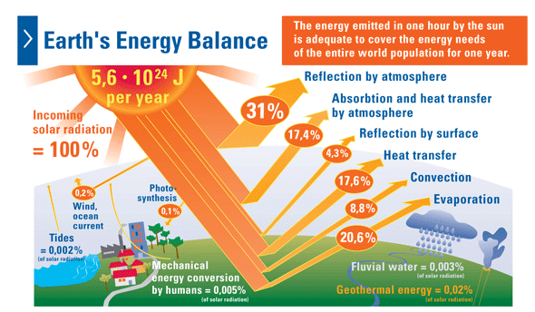
Climate change occurs when either side of energy balance is perturbed.
Figure: Hydrogen Ambassadors
Notes:
Earth’s energy comes from solar radiation
Energy balance: In=Out (in equilibrium)
Source of picture: http://www.hydrogenambassadors.com/background/earths-energy-balance.php

Slide 3
Greenhouse Effect
Figure: Penn State University
Notes:
Greenhouse Effect: Difference between surface temperature/radiation & Earth’s effective temperature/radiation
Source of picture: https://www.e-education.psu.edu/earth501/content/p5_p7.html

Slide 4
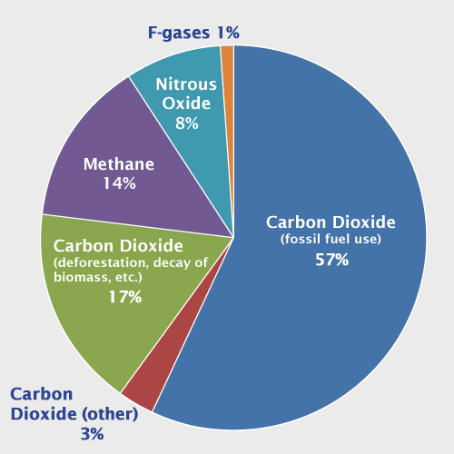
What are the Greenhouse Gases?
Figure: Environmental Protection Agency
Notes:
Relative impacts of different GHGs arise from differences in spectral properties, abundance & lifetime
Increasing GHGs (particularly CO₂) result from small imbalance in large natural exchanges, caused by the addition of anthropogenic emissions.
(source of picture + explanation of all gases: http://www.epa.gov/climatechange/ghgemissions/global.html)

Slide 5
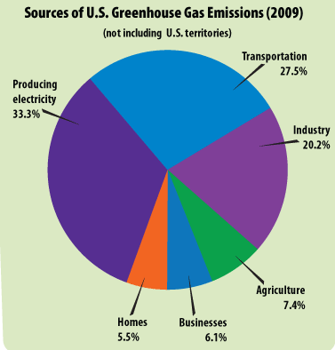
Sources of US Greenhouse Gases
Emissions
Greenhouse Gases & Aerosols
Fossil fuels (Personal & Industry)
Land use
Land use changes
Agriculture
Deforestation
Urbanization
Water management & reservoirs
Figure + Information: Environmental Protection Agency
Notes:
Source of picture + info: http://epa.gov/climatestudents/basics/today/greenhouse-gases.html
More info: http://www.epa.gov/climatechange/ghgemissions/global.html

Slide 6
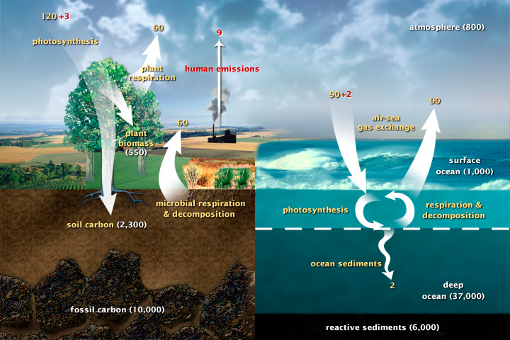
The Carbon Cycle
Figure: National Aeronautics and Space Administration
Notes:
Source of picture: http://earthobservatory.nasa.gov/Features/CarbonCycle/

Slide 7
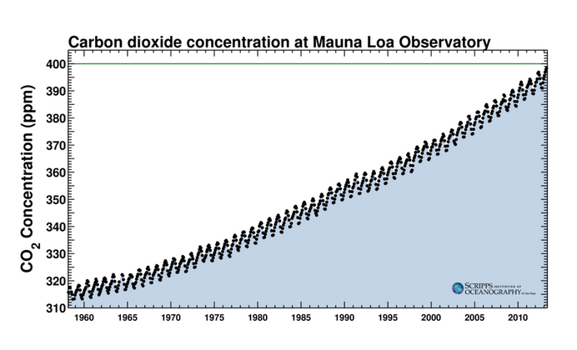
The Keeling Curve
Figure: Scripps Institution of Oceanography
Notes:
Why is there fluctuation in CO2?

Slide 8
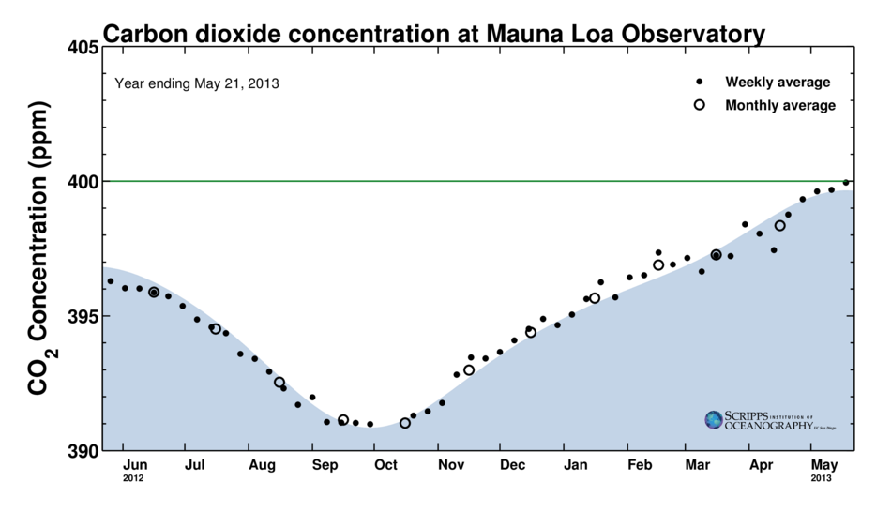
The Keeling Curve
Figure: Scripps Institution of Oceanography
Notes:
Recent passing of 400 ppm- why does it matter?

Slide 9
Climate Impacts
A couple good sites to use as a jumping off point-
http://climate.nasa.gov/effects
http://www.nature.org/ourinitiatives/urgentissues/global-warming-climate-change/threats-impacts/index.htm
Notes:
These are just a few examples - there are many more – ie small island nations, public health issues.

Slide 10
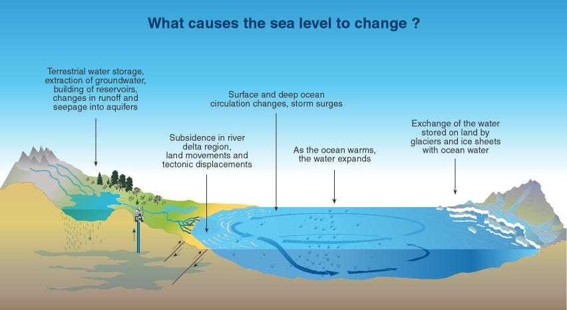
What causes sea level to change?
Figure: Climate.org
Notes:
In case SLR is something they really want to talk about, this is a good explanatory slide
http://www.climate.org/topics/sea-level/

Slide 11
Climate Change Impacts: Real Time
Sea Level Trends: http://tidesandcurrents.noaa.gov/sltrends/sltrends.shtml
Ice Trends: http://nsidc.org/cgi-bin/bist/bist.pl?config=seaice_index

Slide 12
Adaptation, Case Study of The Northweat
Adaptation in general - http://www.epa.gov/climatechange/impacts-adaptation/
NE Specific - http://www.epa.gov/climatechange/impacts-adaptation/northeast.html

Slide 13
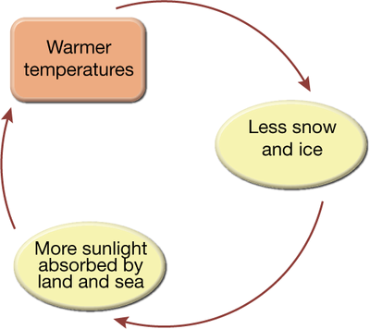
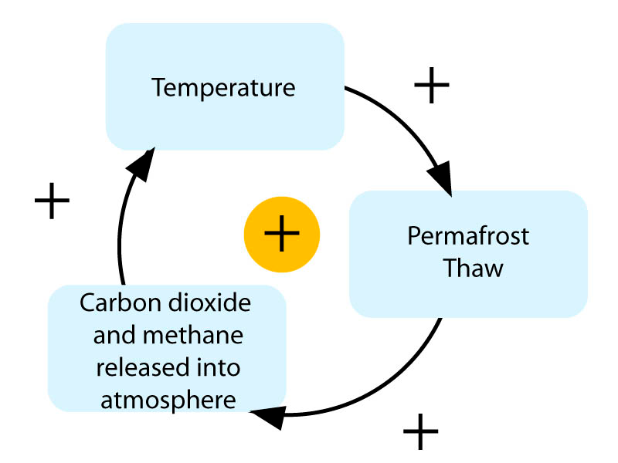
Feedback Loop Examples
Albedo Feedback
Permafrost Feedback
Figure: Carlton College
Notes:
First one- albedo; second one – permafrost
http://serc.carleton.edu/eet/albedo/part_5.html

Slide 14
Experiment Discussion
http://www.epa.gov/climatestudents/impacts/signs/glaciers.html

